Slide 1
SUPERSTORE SALES ANALYSIS
NAME : AKSHAYA G R
INTERNSHIP OF DATA ANALYTICS

Slide 2
BUSINESS QUESTIONS
Business Question
How can Superstore improve sales and profitability using historical sales data?
Objectives
Analyze sales performance
Identify profitable categories
Analyze regional performance
Provide business recommendations

Slide 3
DATASET OVERVIEW
Item | Details
Dataset Name | Sample Superstore
Records | 9994
Columns | 21
Source | Superstore Dataset
DATASET INFORMATION

Slide 4
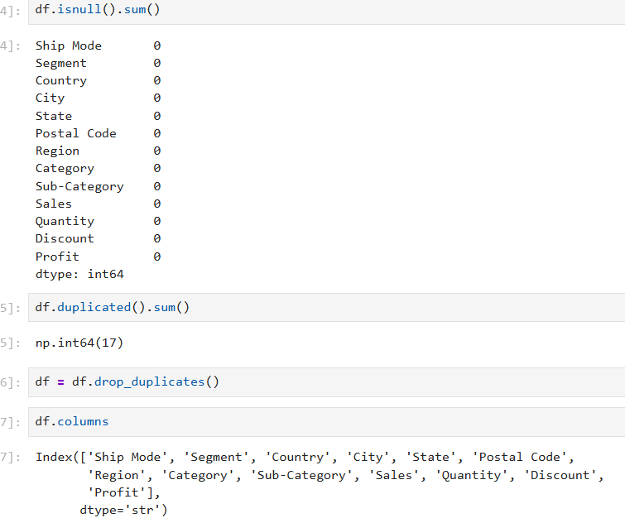
DATA CLEANING
Data Cleaning Process
✔ Checked missing values
✔ Removed duplicate records
✔ Verified data types
✔ Prepared data for analysis
Tools Used
Python
Pandas
Jupyter Notebook

Slide 5
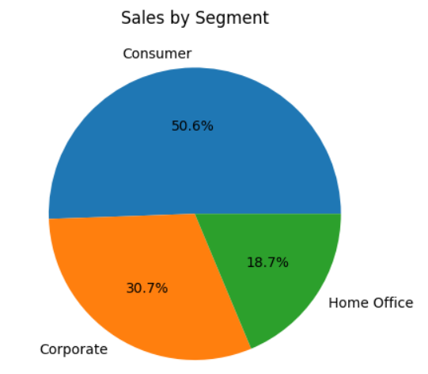
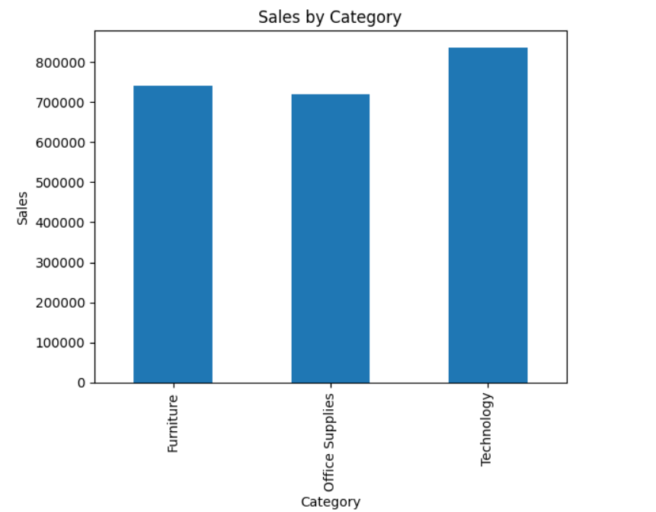
SALES ANALYSIS
HIGHEST SALES BY CATEGORY:TECHNOLOGY
HIGHEST CONTRIBUTION SEGMENT:CONSUMER

Slide 6
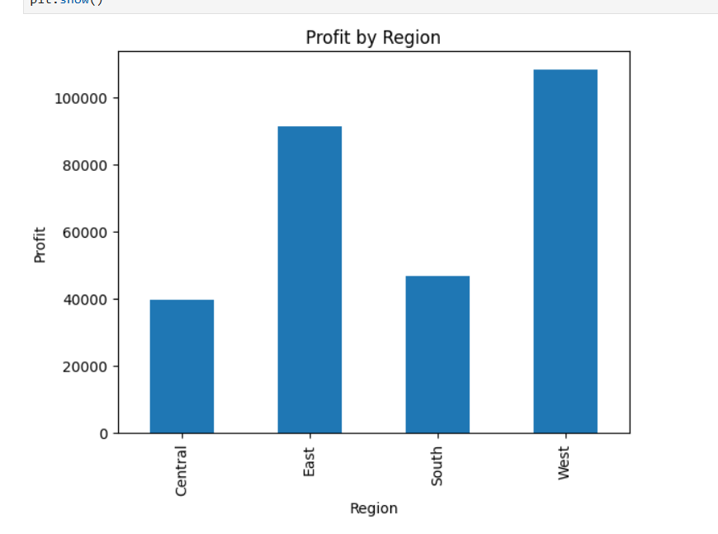
PROFIT ANALYSIS
MOST PROFIT REGION : WEST

Slide 7
KEY INSIGHTS
Technology category generated the highest sales.
West region produced the highest profit.
Consumer segment contributed the largest sales share.
Some products had high sales but lower profitability.

Slide 8
RECOMMENDATIONS AND CONCLUSION
Recommendations
Incase marketing for high-performing categories.
Improve profitability of low-margin products.
Expand successful regional strategies.
Optimize inventory management.

